Slide 1
Mood Journal Analyzer with Geeta Integration
A Full Stack Emotion-Aware Spiritual Companion
~ Blending Ancient Wisdom with Modern Wellness Technology for a Holistic, Offline Experience.
By Chahat Modi

Slide 2
Problem Statement
Many individuals struggle to identify, track, and reflect on their emotional states in daily life.
Existing journaling tools often lack personalization, cultural relevance, and engaging features.
Low engagement and limited emotional growth are common due to generic approaches
Crisis moments are often not detected in current tools.
There is a significant need for tools that offer specialized, culturally relevant support for specific user demographics, such as women's health.
Bhagavad Mood Journal provides a personalized, offline, desktop-based solution with sentiment analysis, reframing, and Gita wisdom.

Slide 3
Objectives / Goals
Build a Tkinter-based desktop application for journaling.
Use NLP (TextBlob) to classify mood from thoughts.
Provide positive reframes & Bhagavad Gita shlokas for guidance.
Feature for tracking a female's menstrual cycle, including symptoms, flow, and energy levels.
Implement a To-Do list with time-based reminders to help users manage tasks and regain clarity.
Add gamification (Spin Wheel) for motivation.
Enable entries management (search, view, export to CSV).
Ensure offline functionality with MySQL local storage.
Show mood statistics for user reflection.

Slide 4
Scope
Frontend: Tkinter multi-frame UI with gradient themes, a dedicated period journal view, and a To-Do list frame.
Backend: Python (OOP, regex-based crisis detection, reframing logic).
NLP : TextBlob + mood keyword matching with sentence-level analysis for sarcasm and negation.
Database: MySQL (users, journal entries, period logs).
Visualization: Matplotlib (mood statistics and period analytics).
Data Export: CSV export for both general and period-specific entries
Gamification: Spin Wheel with motivational messages that auto-save to the journal.
Resources: Self-care tips, facts, quotes, book suggestions, and user-submitted community resources.

Slide 5
Methodology
UI/UX: Tkinter with modular frames (Login, Journal, Entries, Export, Resources, Spin Wheel, Stats, Period Journal, To-Do Notes)
Sentiment Analysis: TextBlob polarity + subjectivity with enhanced mood mapping for nuanced detection.
Crisis Detection: Immediate and prominent regex-based match for sensitive keywords to prioritize user safety.
Reframing: Mood-specific & thought-specific replacements.
Shloka Mapping: A dictionary mapping moods to specific Bhagavad Gita verses and their meanings.
Period Tracking: A dedicated logging interface for physical symptoms, flow, and energy levels.
To-Do List: Local text file storage with a background thread for reminder notifications.
Database: MySQL storage for user accounts, all journal entries, and resource submissions.
Visualization: Matplotlib Pie Charts for overall mood distribution and line graphs for period-related stats over time.
Export: CSV export for personal data backups.

Slide 6
Timeline
Week 1: Initial UI setup using Tkinter and core frame structure.
Weeks 2-3: Implemented MySQL database integration for users and journal entries. Added core sentiment detection logic.
Week 4: Integrated Bhagavad Gita shloka mapping and thought reframing logic.
Week 5: Developed the Spin Wheel gamification feature and built the comprehensive Resources page.
Week 6: Created mood statistics visualizations with Matplotlib and implemented the full CSV export functionality.
Week 7 (Latest Phase): Developed the new Period Journal and To-Do list features. Refined crisis detection and reframing.

Slide 7
Roles
Python Developer: Tkinter UI, backend logic, and feature implementation (e.g., period tracking, to-do list).
Database Engineer: MySQL setup and management of user and journal data.
NLP Engineer: Sentiment analysis, mood detection, and reframing logic.
UI Designer: Responsible for the user experience, including gradient backgrounds and frame layouts.
Tester: Conducts functional and usability testing across all new and existing features.

Slide 8
Expected Outcomes
A functional and comprehensive offline desktop application for journaling.
Accurate mood detection and reframed thoughts.
Bhagavad Gita wisdom integrated into daily journaling.
Gamified engagement with Spin Wheel messages.
Holistic wellness tracking for both emotional and physical health.
Mood trend visualization for personal growth.
Exported data for offline storage or sharing.

Slide 9
System Architecture
Frontend (UI Layer): Tkinter frames (Login, Register, Journal, Entries, Export, Spin Wheel, Resources, Stats, Period Journal, To-Do Notes).
Business Logic Layer: Python classes managing Sentiment Analysis, Crisis Detection, Reframing, Shloka Mapping, Period
Tracking, and CSV Export.
Database Layer: MySQL for user accounts, journal entries, and period logs.
Integration Layer:
TextBlob (NLP)
Matplotlib (Stats Visualization)
CSV Module (Data Export)
tkinterPdfViewer (PDF Reader)

Slide 10
User Journey
Launch application → Login/Register.
Enter thought → Submit.
App detects mood, shows shloka & reframe.
Optionally, log period-related symptoms, energy, and flow.
Save entry automatically.
Explore → Past Entries, Export, Mood Stats.
Spin Wheel for a motivational boost.
Access Resources (facts, tips, books, tailored suggestions).

Slide 11
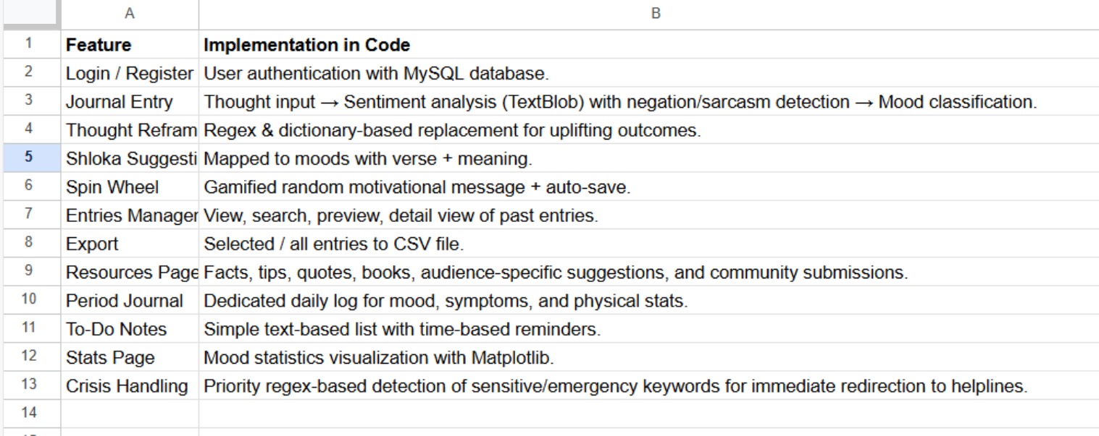
Feature Mapping

Slide 12
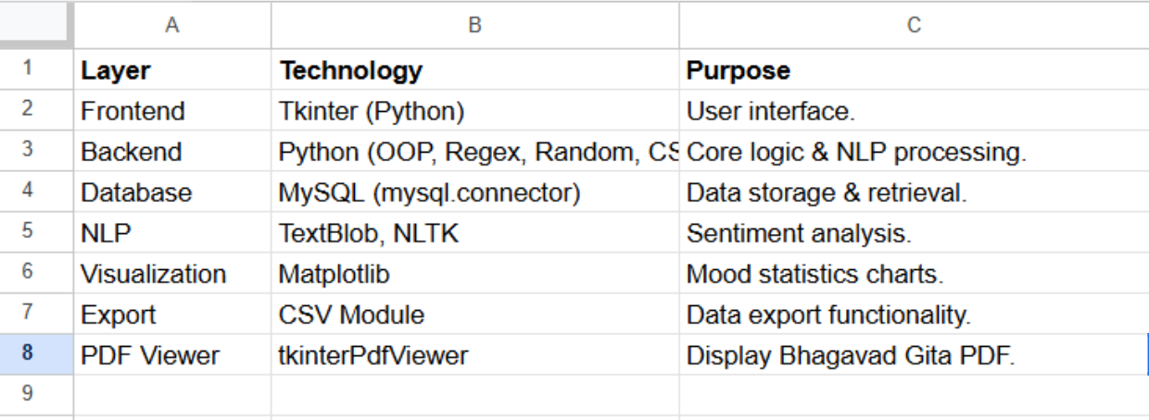
Tech Stack

Slide 13
Future Scope (Phased Expansion)
LLM-Powered Conversational Agent (Gemini): Integrate a chatbot for real-time, empathetic, and interactive support. This will provide dynamic responses beyond the static reframes.
AI-powered Mood Prediction: Move beyond simple polarity to advanced, context-aware mood detection using deep learning models.
Cloud Sync + Cross-Platform Integration: Sync entries across devices for continuous tracking and clinician integration.
Multimodal Data Inputs: Add voice/speech-based analysis for mood detection.
Customizable Themes & Accessibility Options: Allow users to personalize the app's appearance.
Community Support with Categorization: Build a Quora-like community forum where users can anonymously share and discuss life experiences, categorized by profession/student status, age, and physical health.
Integration with Wearables: Capture mood and stress data from smartwatches for a more holistic analysis.

Slide 14
Features from Research Tools (Not Yet in My App)
(Enhancement ideas to expand scope)
Multimodal Data Inputs
  Voice / speech analysis for mood detection (ScienceDirect 2025)
  Image-based emotion recognition (faces, expressions).
Deep Learning NLP Models
  Depression detection using transformer-based models (BERT, RoBERTa) trained on journal-entry datasets (ResearchGate 2024).
Severity Scoring & Early Warning
  Assign “risk levels” (mild, moderate, severe) instead of just mood tags (Sentiment Analysis Challenges, 2023).
Conversational Agent (Chatbot)
  MindLens AI integrates chat-like interactions, making the journaling more interactive (MindLens GitHub).
Cloud Integration
  Sync entries across devices for continuous tracking & clinician integration.
Community Support
  Anonymized peer-sharing or supportive feedback (experimental in research prototypes).

Slide 15
How They Enhance My Project
.
Moves app from rule-based (regex, keyword) → AI-powered insights.
Expands beyond text-only journaling → Physical Symptom Tracking, voice, multimodal inputs.
Provides early warning systems for mental health risks → Provides a safety-first approach with immediate, hardcoded crisis detection, then enhances engagement with an LLM for general conversation
Increases interactivity & engagement (chatbot, community) & Holistic Journaling .
Strengthens long-term impact through cloud-based tracking & integration with therapy support.

Slide 16
Novelty & Unique Selling Proposition (USP)
Academic Context & Gaps Addressed
Broad Sentiment Analysis Limitations
Research highlights challenges in applying generic sentiment analysis to mental health: detecting subtle emotional cues, understanding diverse linguistic contexts, and differentiating clinical states from ordinary mood variations ResearchGate.
Social Media vs. Private Journaling
Studies show NLP models trained on journal entries more accurately detect depressive patterns, compared to social media data research-archive.orgResearchGate.
Treatment Gaps in LMICs
Globally, 76–85% of individuals in low- and middle-income countries lack adequate mental health care—a gap digital tools can help bridge Wikipedia.
Tool Limitations in Existing Projects
MindLens AI analyzes mood from general text inputs, but lacks reframing mechanisms or integration of culturally resonant spiritual elements GitHub.

Slide 17
My Project’s Distinctive Advantage
Culturally Tailored Sentiment Analysis: Unlike general tools, your app contextualizes emotional states via Bhagavad Gita shlokas—offering spiritually and culturally meaningful guidance.
Offline, Desktop-Based Accessibility: Operates without internet—ideal for users in low-connectivity settings or with privacy concerns.
Emotion Reframing + Crisis Detection: Beyond classification, your app actively reframes negative thoughts into uplifting perspectives. It also includes regex-based crisis detection for immediate user safety.
Gamified Engagement with Spin Wheel: Adds motivational flair to journaling via gamification—not commonly found in academic or commercial counterparts.
Mood Visualization & Export: Enables users to reflect on emotional trends via charts and preserves data with export capability—a combination of introspection and control.
Holistic, Offline Mental Wellness Tool: Blends traditional wisdom, offline usability, and interactive features into a self-contained nurturing journal, addressing both emotional and cultural dimensions.

Slide 18
Interdisciplinary Scope
Haptic Feedback Simulation (Electronics + CSE)
🔹 What it means:
Haptic feedback = “touch-based responses” (like vibration when your phone receives a notification).
In your project, haptic feedback could be simulated to give users a physical sense of reassurance or positivity when certain moods are detected.
🔹 How to simulate as a student:
Instead of real vibration motors, you can:
  Use Unity, MATLAB, or Python game libraries (like Pygame) to simulate the effect (visual shake + sound → representing vibration).
  Generate vibration patterns as waveforms (using Python + matplotlib) → show how a motor would behave.
  In advanced setups, connect an Arduino simulation in Proteus to demonstrate how a vibration motor would activate on “negative mood detected.”
🔹 Example for your app:
If mood = Sad → simulate a short vibration + display a positive shloka.
If mood = Happy → simulate a lighter, playful buzz.
🔹 Why it’s useful:
Adds multi-sensory engagement → beyond just visual text.
Can be demoed without hardware using software simulations.
Makes your project look like a cyber-physical wellness system (touch + sight + software).

Slide 19
Interdisciplinary Scope
How it works in practice:
The project’s architecture considers how a physical, desktop-based journaling device would function, with a simulated "physical journal console, buttons, or a Spin Wheel".
The software simulates a mechanical response. The mood-based color transition mimics a "haptic feedback" system, giving users a "physical sense of reassurance or positivity".
This demonstrates how principles of "Computer-Aided Design (CAD)" and physical interface design are applied to software to create a more immersive experience.
Why it’s useful:
It adds a multi-sensory component to the journaling process, making it more engaging and effective.
It allows you to pitch the app as a concept for ergonomic devices or wellness kiosks, showing "interdisciplinary collaboration between Mech (3D modeling), CSE (UI logic), and Electronics (sensors)

